Slide 1
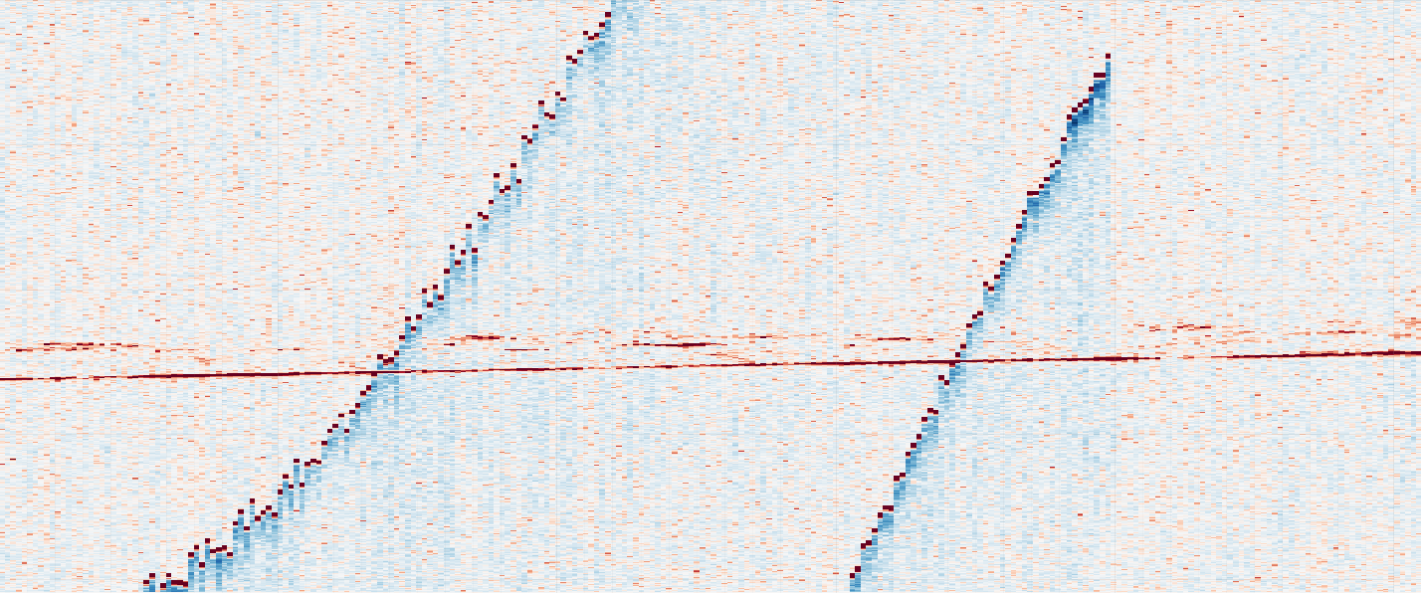
Data
CASALS L1B is a calibrated/geolocated sensor-level HDF5 product. In the current analysis, we use the refh reference-return fields as a Level-A point representation, together with signal attributes such as amplitude, background statistics, and SNR.
H5 file:
refh_longitude refh_latitude refh_height refh_snr refh_amp refh_thres good_snr track_num sweep_num
bg_mean bg_std
……
Range →
Track Index

Slide 2
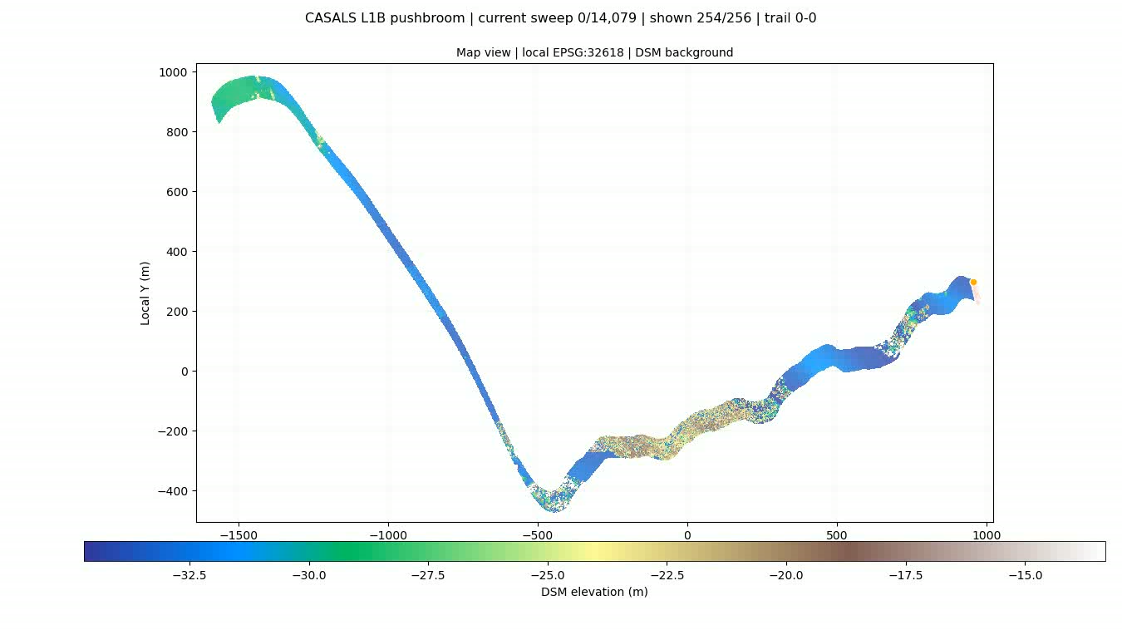
Data

Slide 3
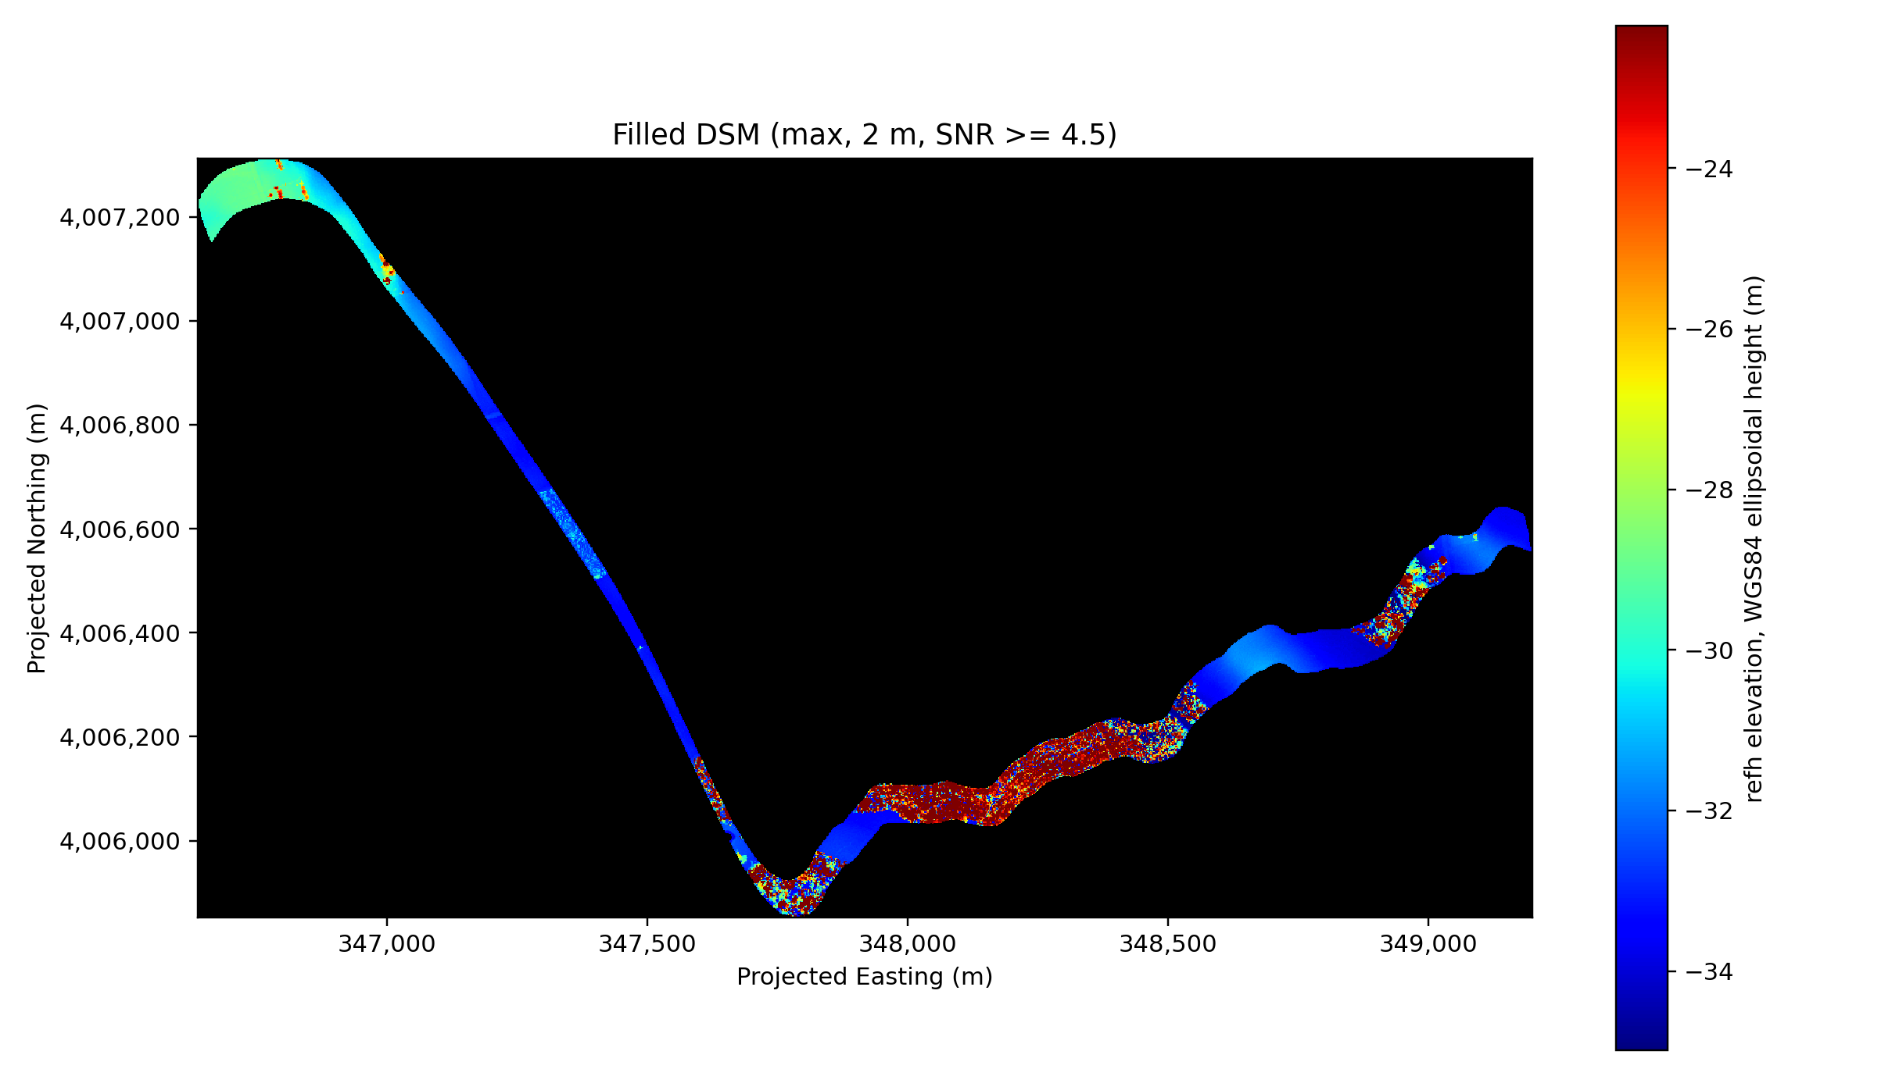
DSM
WGS84 ellipsoidal height, UTM Zone 18N
DSM is generated using points whose SNR>=4.5. Max elevation is taken; 2m DSM resolution.

Slide 4
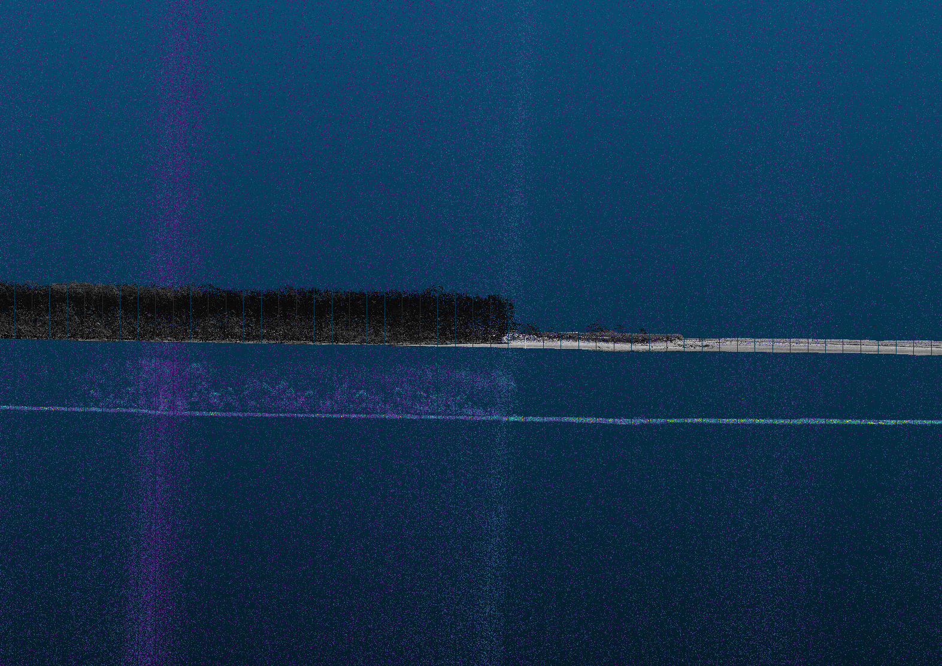
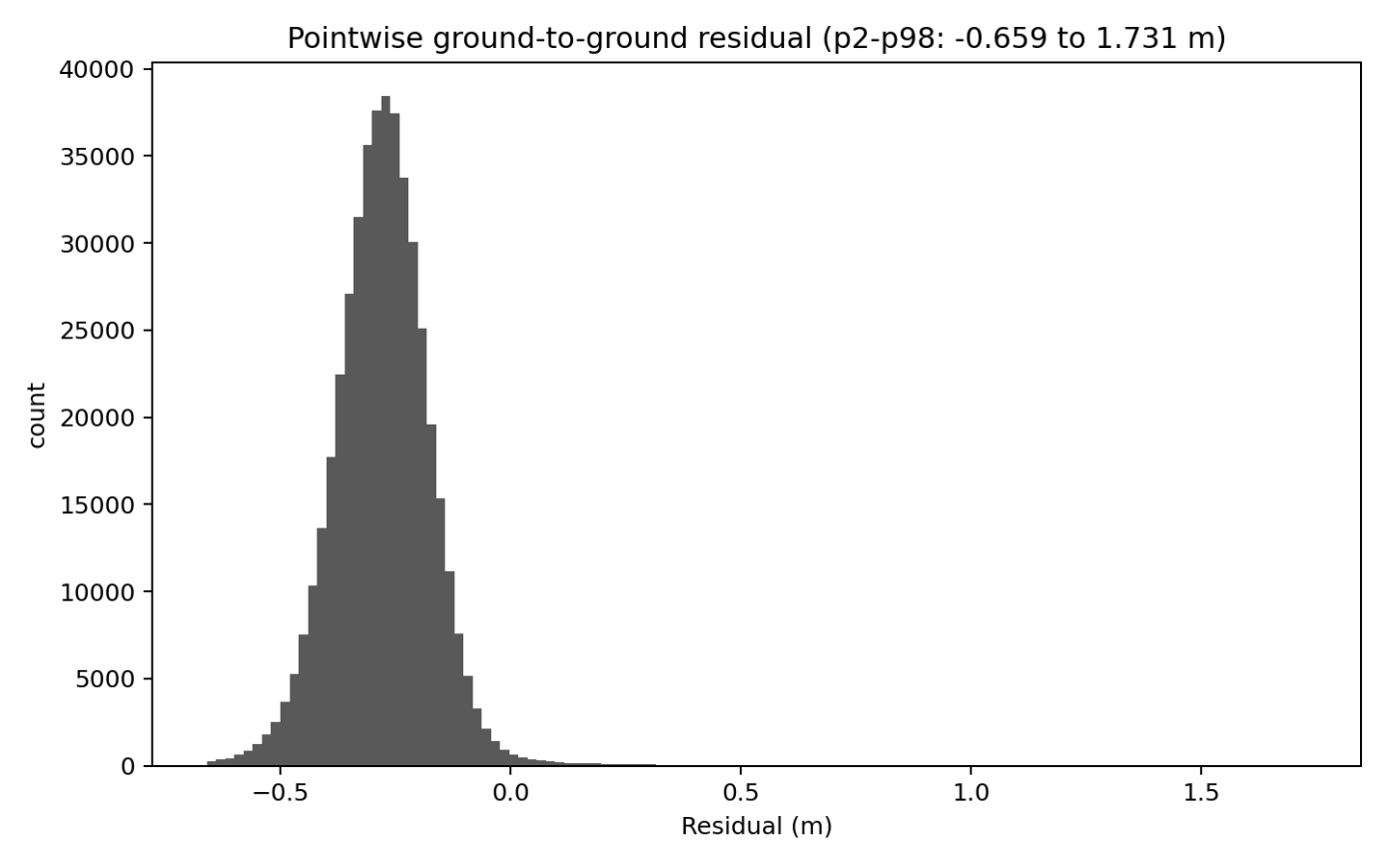
Elevation
Histogram of residuals after transformation
3DEP
CASALS
Raw CASALS - 3DEP height difference is large and stable, about −37.6 to −38.0 m, mainly reflecting a mixed elevation datum difference rather than measurement error.
CASALS is based on WGS84 ellipsoidal height, while 3DEP uses NAVD88 orthometric height.
Full WGS84 3D transformation removes a shift of about −37.1 to −37.7 m and reduces the ground-to-ground residual to −0.28 to −0.52 m.

Slide 5
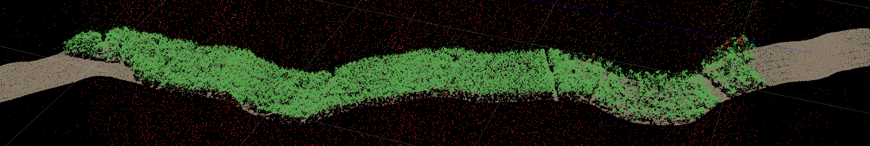
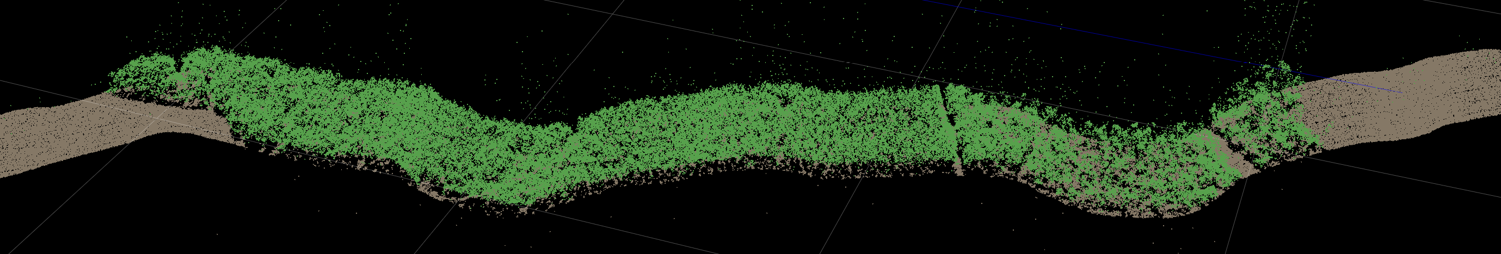
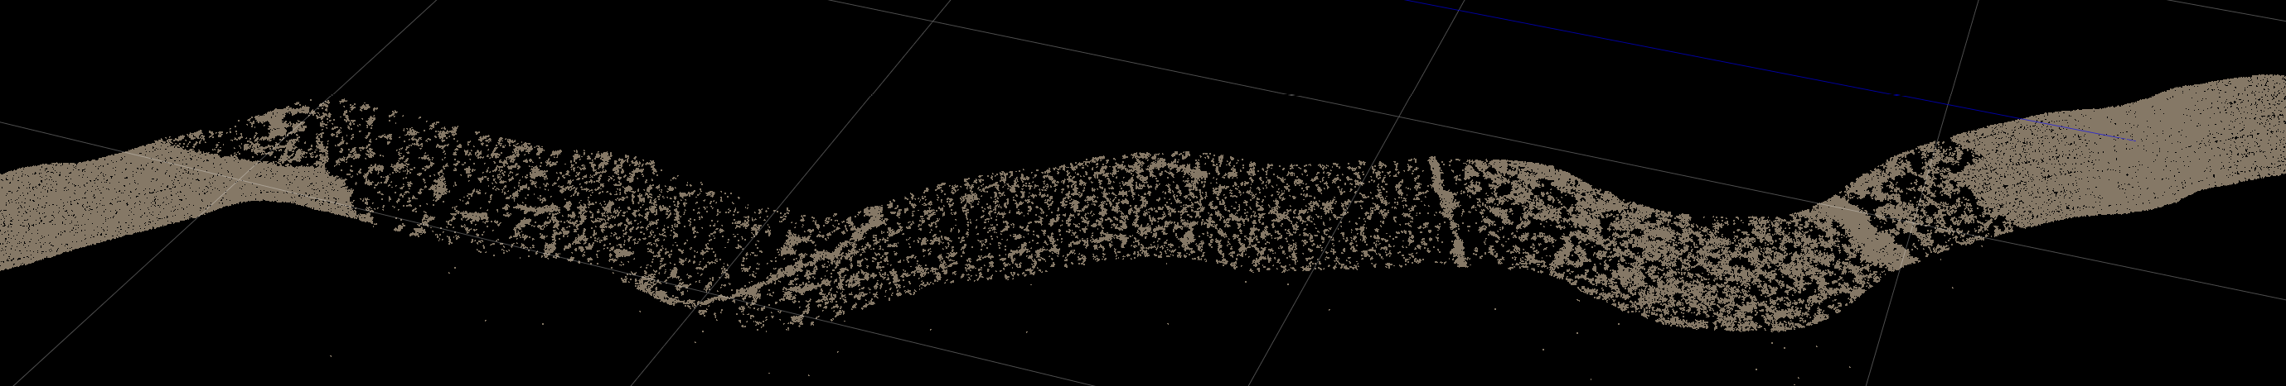
Classification: ground and vegetation
Data: casals_l1b_20241118T171757_001_02
Red points for noise
Full Points
Green points for surface cover
Filtered Points
Grey points for ground
Ground Points

Slide 6
Understanding & Suggestion
Current Understanding
CASALS L1B is a geolocated waveform product: it provides full transmit/receive waveforms and one geolocated reference return per pulse.The reference return represents the strongest receive-waveform bin, which is one selected waveform bin.
There are no confirmed stored longitude/latitude/height for other points along the same beam.
Beam-angle and range-window information are present and meaningful, but the angle convention and the full range-bin mapping are not yet sufficiently documented for independent georeferencing.
If the time/range sampling and beam geometry are fully defined, other waveform bins may be converted to derived coordinate candidates. Without this definition, those coordinates remain uncertain.
Suggestion
Preserve or document complete waveform georeferencing information.
Ideally, provide either explicit coordinates for waveform bins/peaks, or a fully specified beam/range model that supports coordinate derivation (Clarify beam-angle convention, sampling/range definition, sign convention, one-way versus two-way range treatment, and applied corrections).

